Slide 1

"United States Interest Rates and Property Market Dynamics"
"An Analysis from 2010 to 2023“
Presented by: Gabriel Adriano

Slide 2

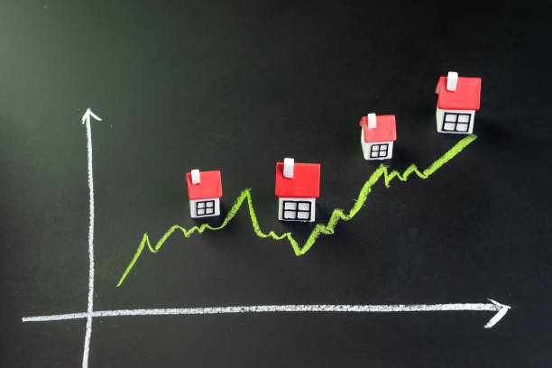
Introduction
How do changes in interest rates impact property prices? We'll navigate through the data accessed through Zillow and Bank for International Settlements (BIS) and look for insights to understand whether interest rates have an effect on the property markets in the United States.

Slide 3

Analysis
Run all of the code blocks in Jupyter Notebook to ensure that all dataframe tables and visualizations are created.
To read through the analysis, scroll down to the "Analysis" section of the code blocks.
The code blocks are separated into different sections:
Import modules
Data Tabulation
Data Visualization
Analysis
4. The visualizations are only visible from the "Analysis" section.

Slide 4
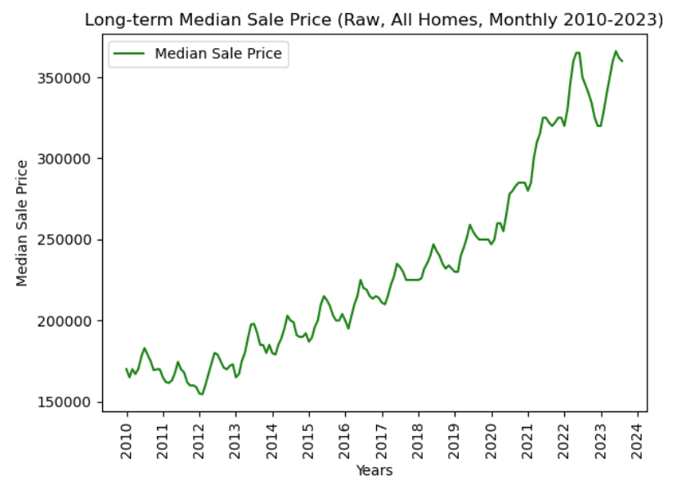
Long-term Median Sale Price (Zillow)
When examining the trends in the Median Sale Price using Zillow's SRAM indicator, a notable pattern emerges. Between 2010 and 2012, the median sale price in the United States displayed a declining trajectory. However, from 2012 onward, there was a distinct shift towards a sustained upward trend. It's important to emphasize that this upward trajectory was not without interruptions; it featured periodic fluctuations with instances of both decline and recovery.
Rate Hikes Start
Pandemic
Stimulus

Slide 5
Long-term Median Sale Price (Zillow)
The U.S. housing market was in the process of recovery from the global financial crisis of 2008 and the subsequent housing market crash. As economic conditions improved, consumer confidence surged, spurring greater demand for residential properties. The stabilization of the economy bolstered consumer confidence. As individuals grew more secure in their financial situations and job prospects, a noticeable uptick in housing market participation was observed.

Slide 6
Long-term Median Sale Price (Zillow)
A distinct dip in median property prices became evident in the middle of 2022, aligning with the Federal Reserve's decision to raise interest rates. Despite these fluctuations, an overall trend emerges, characterized by a consistent long-term growth in median sale prices.

Slide 7
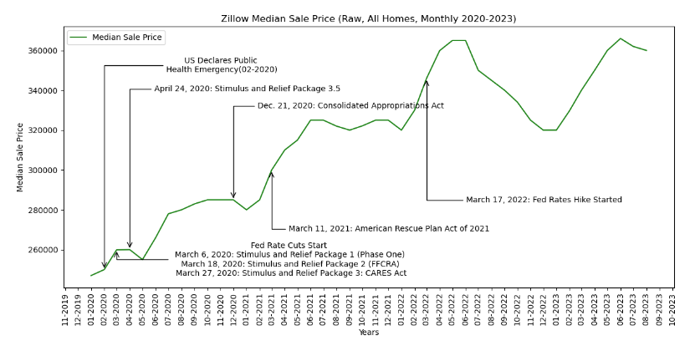
Median Sale Price during the Pandemic and the Rise of Interest Rates
Economic Stimulus and Pandemic Impact (March 2020 - May 2020): Median house prices plateaued, reflecting the uncertainty and economic challenges posed by the pandemic, as well as the declaration of a U.S. public health emergency. Buyers and sellers were cautious due to these unprecedented circumstances.

Slide 8
Median Sale Price during the Pandemic and the Rise of Interest Rates
In May 2020, there was a notable change in the trend, as median house prices began to increase. The pandemic brought demands for more space, particularly from young urban households whose family formation moves were greatly accelerated in the wake of the pandemic.

Slide 9
Median Sale Price during the Pandemic and the Rise of Interest Rates
Plateau and Affordability Concerns (June 2021 - February 2022): The plateauing of prices around June 2021 might have been influenced by factors such as affordability concerns and housing market fatigue, especially in markets that had experienced rapid price growth.

Slide 10
Median Sale Price during the Pandemic and the Rise of Interest Rates
Resurgence and Interest Rate Hikes (February 2022 - January 2023): In February 2022, the housing market started to increase again. The anticipation of rising rates might have motivated buyers to enter the market before borrowing costs became more expensive.

Slide 11
Median Sale Price during the Pandemic and the Rise of Interest Rates
The market peaked in June 2022, driven by a combination of factors, including low inventory, strong demand, and increased interest rates. Decline and Recovery (June 2022 - January 2023): After the peak, there was a period of declining prices, which extended until January 2023. This decline could be attributed to affordability issues, as rising prices and interest rates made it more challenging for some buyers.

Slide 12
Median Sale Price during the Pandemic and the Rise of Interest Rates
Recent Resurgence (January 2023 - June 2023): From January 2023, there was another upswing in median house prices, ultimately reaching the same peak as in June 2022 by June 2023. This resurgence could be attributed to various factors, including improved economic conditions, continued demand for housing, and potential adjustments in the housing market.

Slide 13
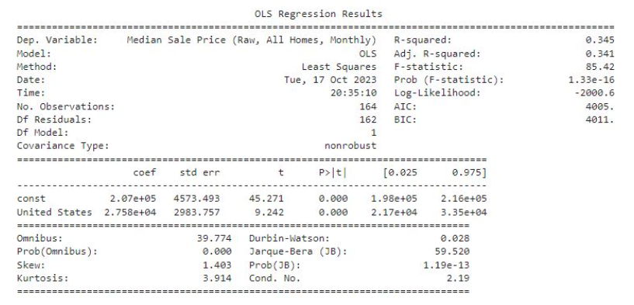
Hypotheses and Analysis Method
Null Hypothesis (H0): There is no statistically significant relationship between changes in interest rates and property prices in the United States.
Alternative Hypothesis (H1): There is a statistically significant relationship between changes in interest rates and property prices in the United States.
Method: Time-series regression analysis
Rationale: Time-series regression analysis is commonly used in various fields, including economics, finance, and social sciences, when you want to understand and model how a particular variable changes over time.
Model: Ordinary Least Squares (OLS) regression model

Slide 14
Hypotheses and Analysis Method
P-value for the 'interest rate' coefficient: 1.3320868257407982e-16
Critical F-value at alpha = 0.05: 3.899502435176602
F-statistic: 85.42 is much larger than Critical F-value: 3.8995, indicating that the model is statistically significant at the 0.05 significance level.
This suggests that interest rates have a statistically significant effect on property prices. We reject the null hypothesis. In summary, the regression results indicate that United States interest rates are statistically significant in explaining variations in property prices.

Slide 15
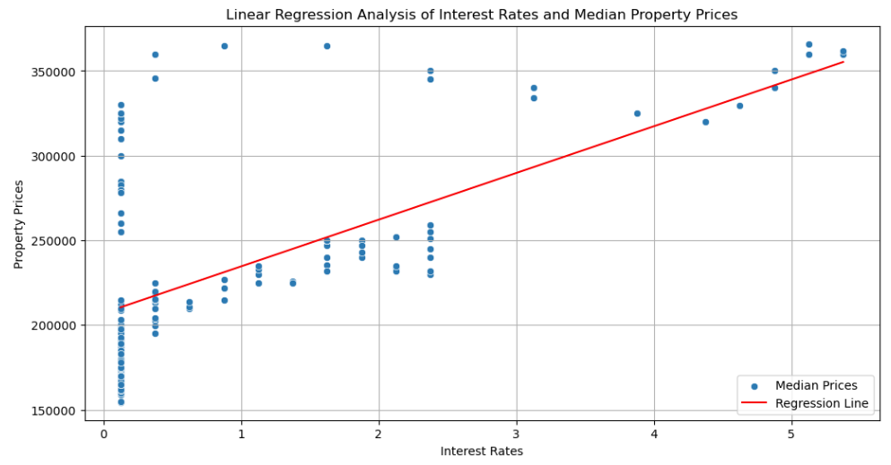

Slide 16
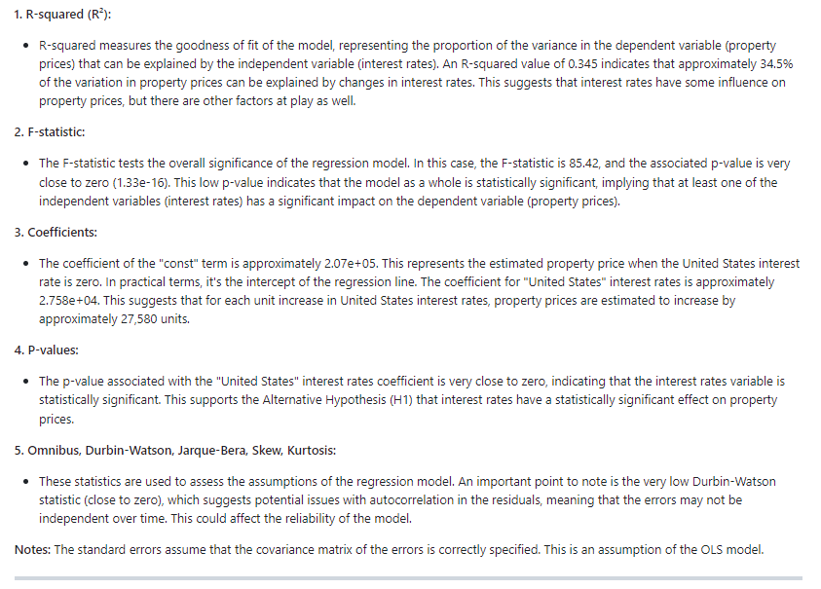
OLS MODEL Result Explainer

Slide 17
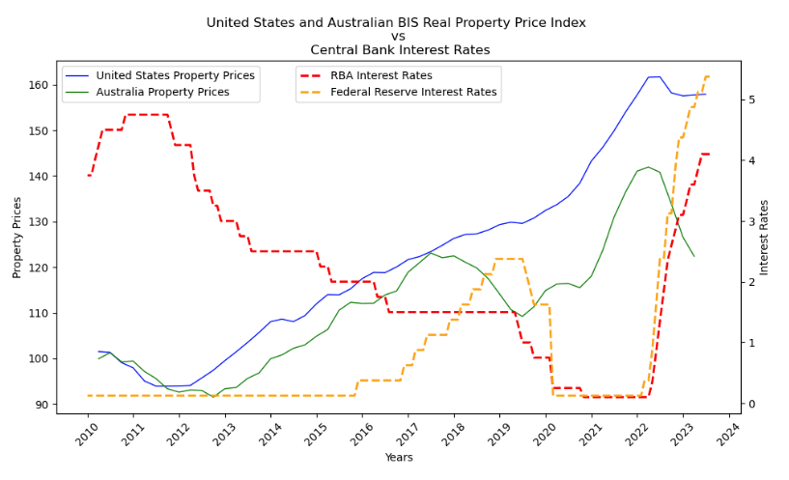
BIS Real Property Price Index for the United States and Australia
United States: The interest rates in the United States have been relatively higher than in Australia over the entire period, with a range from 0.125% to 5.375%. The Real Property Price Index for the United States has generally increased over the years.

Slide 18
BIS Real Property Price Index for the United States and Australia
United States: The interest rates in the United States have been relatively higher than in Australia over the entire period, with a range from 0.125% to 5.375%.
The Real Property Price Index for the United States has generally increased over the years. It started around 101 in 2010 and reached approximately 157 in 06-2023.
In index terms, it would mean that the same property around 2010 is now 50% more in value.

Slide 19
BIS Real Property Price Index for the United States and Australia
Furthermore, Zillow's SRAM indicator, which measures the Median Sale Price (Raw, All Homes, Monthly), supports these observations wherein the price from 2010 has almost doubled in 2023.

Slide 20
How does it compare to the Australian Market?
Australia: The interest rates in Australia also saw variation during the period but remained generally lower than in the United States, with a range from 0.125% to 4.10%.
The Real Property Price Index in Australia increased over the years, indicating a general upward trend in property prices. It started around 99 in 2010 and reached approximately 122 in 03-2023.
In index terms, it would mean that the same property around 2010 is now 22% more in value.

Slide 21


Conclusion
The United States generally maintained its housing market price uptrend compared to Australia, and this may be due to several factors.
Factors such as strong economic conditions, central bank influence on interest rates, differences in mortgage terms, and the availability of assumable loans in the United States all contribute to the property market dynamics.
In summary, the regression results indicate that United States interest rates are statistically significant in explaining variations in property prices, and while they play a role, they don't explain the entirety of the variation. Further investigation is needed to address potential autocorrelation in the model's residuals.

Slide 22


